Slide 1
Filters and Listeners

Slide 2

Objectives
At the end of this session, you will be able to understand,
Need and functionality of Filters
Need and functionality of Listeners
Copyright © 2016 Tech Mahindra. All Rights Reserved.

Slide 3

Agenda
Following points to be covered in the session,
Filters and their functionality
Creating user defined filters
Types of Listeners
Creating and implementing Listeners
CONFIDENTIAL© Copyright 2008 Tech Mahindra Limited
Copyright © 2016 Tech Mahindra. All Rights Reserved.

Slide 4
Filters
Copyright © 2016 Tech Mahindra. All Rights Reserved.

Slide 5
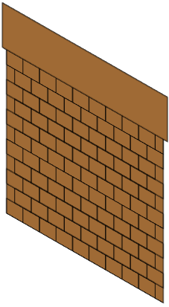


Scenario of Security gate in IT company..
Visitor
Security Gate / Entrance
Company
All the visitors of the company have to pass through security gate where checking is done during entry and exit both. This is done to ensure security is achieved. Security threats are stopped at entry itself to avoid unnecessary challenges.
Copyright © 2016 Tech Mahindra. All Rights Reserved.

Slide 6
Filter Introduction
Servlet Filters are Java classes that can be used in Servlet Programming for the following purposes:
  To intercept requests from a client before they access a resource at back end.
  To manipulate responses from server before they are sent back to the client.
Usage of Filter
  Record all incoming requests
  logs the IP addresses of the computers from which the requests originate
  conversion
  data compression
  encryption and decryption
  input validation
  logging the application
Copyright © 2016 Tech Mahindra. All Rights Reserved.
Notes:
There are are various types of filters suggested by the specifications:
Authentication Filters.
Data compression Filters.
Encryption Filters.
Filters that trigger resource access events.
Image Conversion Filters.
Logging and Auditing Filters.
MIME-TYPE Chain Filters.
Tokenizing Filters .
XSL/T Filters That Transform XML Content.

Slide 7
Filter Introduction (Cont.. )
Advantage of Filter
  Filter is pluggable.
  One filter don't have dependency onto another resource.
  Less Maintenance
Filter API : Like servlet filter have its own API. The javax.servlet package contains the three interfaces of Filter API.
  Filter
  FilterChain
  FilterConfig
Copyright © 2016 Tech Mahindra. All Rights Reserved.
Notes:
There are are various types of filters suggested by the specifications:
Authentication Filters.
Data compression Filters.
Encryption Filters.
Filters that trigger resource access events.
Image Conversion Filters.
Logging and Auditing Filters.
MIME-TYPE Chain Filters.
Tokenizing Filters .
XSL/T Filters That Transform XML Content.

Slide 8
Steps for creating user defined filter with E.g.
Creating UI to access Filter
Creating a Filter class
index.html
<a href="servlet1">click here</a>
MyFilter.java
import java.io.IOException;
import java.io.PrintWriter;
import javax.servlet.*;
public class MyFilter implements Filter{
public void init(FilterConfig arg0) throws ServletException {}
public void doFilter(ServletRequest req, ServletResponse resp,
FilterChain chain) throws IOException, ServletException {
PrintWriter out=resp.getWriter();
out.print("filter is invoked before");
chain.doFilter(req, resp);//sends request to next resource
out.print("filter is invoked after");
}
public void destroy() {}
}
Copyright © 2016 Tech Mahindra. All Rights Reserved.

Slide 9
Steps for creating user defined filter
Creating servlet
HelloServlet.java
import java.io.IOException;
import java.io.PrintWriter;
import javax.servlet.ServletException;
import javax.servlet.http.*;
public class HelloServlet extends HttpServlet {
public void doGet(HttpServletRequest request, HttpServletResponse response)
throws ServletException, IOException {
response.setContentType("text/html");
PrintWriter out = response.getWriter();
out.print("<br>welcome to servlet<br>");
}
}
Copyright © 2016 Tech Mahindra. All Rights Reserved.

Slide 10
Steps for creating user defined filter
Configuring filter in web.xml
<web-app>
<servlet>
<servlet-name>s1</servlet-name>
<servlet-class>HelloServlet</servlet-class>
</servlet>
<servlet-mapping>
<servlet-name>s1</servlet-name>
<url-pattern>/servlet1</url-pattern>
</servlet-mapping>
<filter>
  <filter-name>f1</filter-name>
  <filter-class>MyFilter</filter-class>
</filter>
<filter-mapping>
  <filter-name>f1</filter-name>
  <url-pattern>/servlet1</url-pattern>
</filter-mapping>
</web-app>
Copyright © 2016 Tech Mahindra. All Rights Reserved.
Notes:
Note : In case of multiple filters for single servlet, filters will be executed in sequential order.

Slide 11
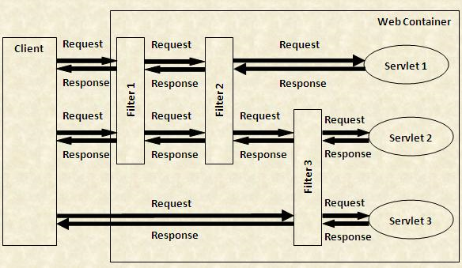
Filter ( Cont.. )
Following diagram explains possible combinations in filter :
Copyright © 2016 Tech Mahindra. All Rights Reserved.

Slide 12

Filters (Cont..)
Best Practices : Use Filters is recommanded for writing pre-processing and post-processing logic for servlets. E.g.
Preprocessing – User authentication before control is passed to servlet. In case authentication fails, servlet execution time can be saved.
Or checking session for a user and allowing user access only if new session
is created.
Post Processing – Log out code implementation after the user clicks on LOG OUT option in website. Also session can be terminated in post processing so that user can not use that session again by clicking on back button.
[ Note : Java Framework named “Struts” is based on filters to automate memory management ,exception handling tasks etc. For achieving this truts uses modified version of Filters called Interceptors. ]
Copyright © 2016 Tech Mahindra. All Rights Reserved.

Slide 13
Listeners
Copyright © 2016 Tech Mahindra. All Rights Reserved.

Slide 14
Listeners Introduction
In a web application various tasks need to be completed. E.g.
  counting total and current logged-in users,
  creating tables of the database at time of deploying the project
  creating database connection object etc.
These tasks must be performed based upon certain event occurrence. JEE gives us the way to identify the events and perform some logic after they are triggered through various event classes and listener interfaces available in Servlet APIs. This technique of handling events with code is called as “EVENT HANDLING”.
In servlet all related APIs are available inside javax.servlet and javax.servlet.http package
Copyright © 2016 Tech Mahindra. All Rights Reserved.

Slide 15






Listener APIs
Event classes : The event classes are as follows:
ServletRequestEvent
ServletRequestAttributeEvent
ServletContextEvent
ServletContextAttributeEvent
HttpSessiontEvent
HttpSessionBindingEvent
Copyright © 2016 Tech Mahindra. All Rights Reserved.

Slide 16
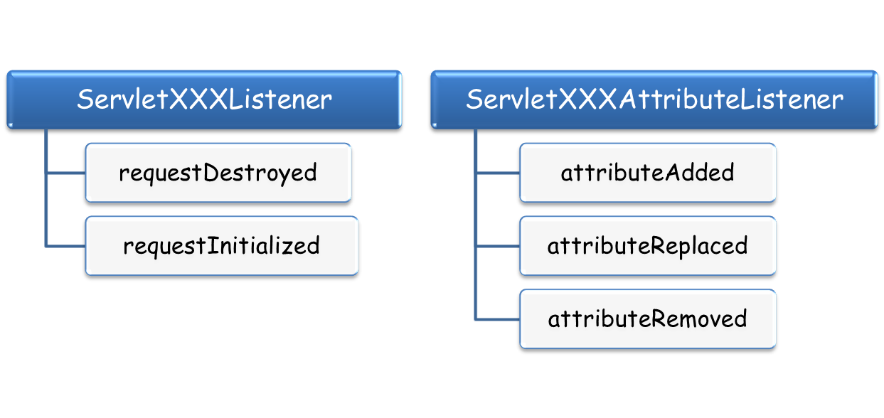
Listener APIs
Event interfaces : The event interfaces are as follows:
Here, XXX can be Request or Context
Session has different interfaces which are mentioned next..
Methods are same for all interfaces and just differ in parameter accepted.
Refer Java Docs or Sample demo’s for details.
Copyright © 2016 Tech Mahindra. All Rights Reserved.
Notes:
1) ServletRequestListener
void requestDestroyed(ServletRequestEvent sre)
Receives notification that a ServletRequest is about to go out of scope of the web application.
void requestInitialized(ServletRequestEvent sre)
Receives notification that a ServletRequest is about to come into scope of the web application.
2) ServletRequestAttributeListener
void attributeAdded(ServletRequestAttributeEvent srae)
Receives notification that an attribute has been added to the ServletRequest.
void attributeRemoved(ServletRequestAttributeEvent srae)
Receives notification that an attribute has been removed from the ServletRequest.
void attributeReplaced(ServletRequestAttributeEvent srae)
Receives notification that an attribute has been replaced on the ServletRequest.
3) ServletContextListener : Useful for doing one time activity like db connection application deployment.
void contextDestroyed(ServletContextEvent sce)
Receives notification that a ServletContext is destroyed so as the web applications inside it.
void contextInitialized(ServletContextEvent sce)
Receives notification that a ServletContext is created and is ready to host the application.
4) ServletContextAttributeListener
void attributeAdded(ServletontextAttributeEvent scae)
Receives notification that an attribute has been added to the ServletContext
void attributeRemoved(ServletContextAttributeEvent scae)
Receives notification that an attribute has been removed from the ServletContext.
void attributeReplaced(ServletContextAttributeEvent scae)
Receives notification that an attribute has been replaced on the ServletContext.

Slide 17



Session Listener APIs
HttpSessionListener
These interfaces can handle events related with session. Eg. Identifying how many users are currently logged in etc.
Eg . Session created or destroyed, session attribute added, replaced or removed etc.
We will consider basic interface only . i.e. HttpSessionListener and HttpSessionAttributeListener
Refer Java Docs for details.
HttpSessionAttributeListener
HttpSessionBindingListener
HttpSessionActivationListener
Copyright © 2016 Tech Mahindra. All Rights Reserved.
Notes:
1) ServletRequestListener
void sessionDestroyed(HttpSessionEvent hse)
Receives notification that a HttpSession is destroyed
void sessionInitialized(HttpSessionEvent hse)
Receives notification that a HttpSession is created
2) ServletRequestAttributeListener
void attributeAdded(HttpSessionBindingEvent sbe)
Receives notification that an attribute has been added to the HttpSession.
void attributeRemoved(HttpSessionBindingEvent sbe)
Receives notification that an attribute has been removed from the HttpSession.
void attributeReplaced(HttpSessionBindingEvent sbe)
Receives notification that an attribute has been replaced on the HttpSession.

Slide 18
Listeners working in servlets
Application lifecycle is controlled by container. To map task execution with application component state, listeners are used.
Container listens to the events occurring and checks if a corresponding listener is configured for application. During this it also check for corresponding event handling method and executes it.
Eg . In Shopping web site daily offers and discount rates should be assigned as soon as application starts for the day. This can be done by listening to application life cycle events.
Listener is configured in web.xml
Based upon requirement Java class should be created which implements any of the listens mentioned earlier. Corresponding method must be implemented in java class to handle respective events.
<web-app>
<listener-class>package.classname</listener-class>
</web-app>
Copyright © 2016 Tech Mahindra. All Rights Reserved.
Notes:
Easy trick :
Various event that can be listen with help of listener interfaces : ( methods are available in interfaces for this)
_______________________ request object ___________________
request created , destroyed
request attribute added , replaced, removed
_______________________ context object ___________________
context created , destroyed
context attribute added, replaced, removed
_______________________ session object ___________________
session created , destroyed
session attribute added, replaced, removed

Slide 19

Summary
In this session, we have covered,
Filters
Listeners
Copyright © 2016 Tech Mahindra. All Rights Reserved.
Notes:
Books :
Head First Servlets and JSP

Slide 20
Thank You
Copyright © 2016 Tech Mahindra. All Rights Reserved.

